Slide 1

Budget Tracker: Take Control of Your Finances
Welcome to our presentation on our groundbreaking budget tracker application, designed to empower you to manage your finances effectively and achieve your financial goals.

Slide 2

Why Budget Tracking Matters
1
1. Financial Clarity
2
2. Spending Control
Gain a clear understanding of your income and expenses.
Identify areas of overspending and make adjustments.
3
3. Savings Potential
4
4. Debt Reduction
Track progress toward savings goals and identify opportunities.
Manage debt effectively and create a plan for repayment.

Slide 3
Key Features of Our Budget Tracker App
User-Friendly Interface
Automated Transactions
Real-Time Updates
Secure Data Encryption
Stay informed with instant updates on your financial status.
Simple and intuitive design for effortless navigation.
Connect bank accounts and credit cards for automatic tracking.
Rest assured that your financial data is protected.

Slide 4
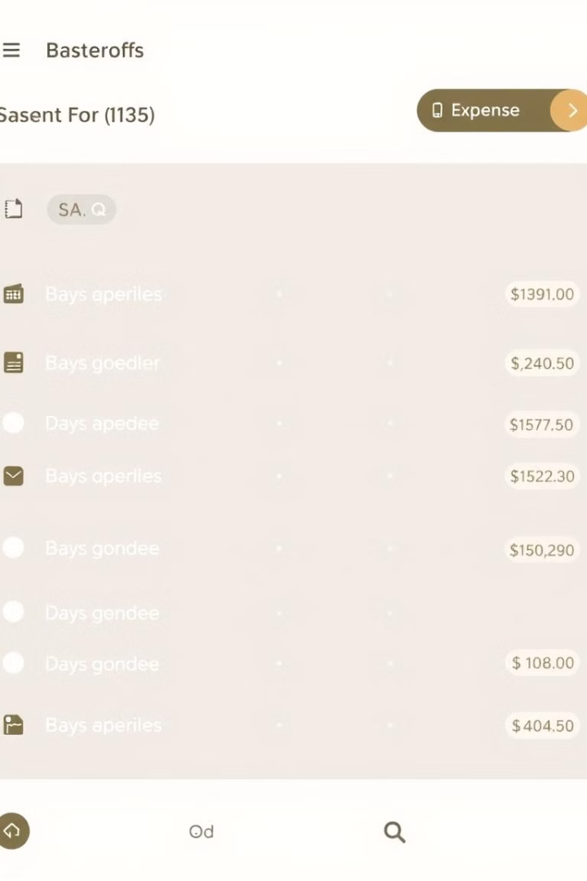



Easy Categorization of Expenses
Automated Tagging
Automatically assign categories to transactions for convenience.
Customizable Categories
Create personalized categories to suit your spending habits.
Detailed Reports
Generate reports to analyze spending by category.

Slide 5



Personalized Budgeting Insights
Spending Trends
1
Track your spending patterns over time.
Goal Progress
2
Monitor your progress towards financial goals.
Personalized Recommendations
3
Receive tailored tips for improving your budget.

Slide 6
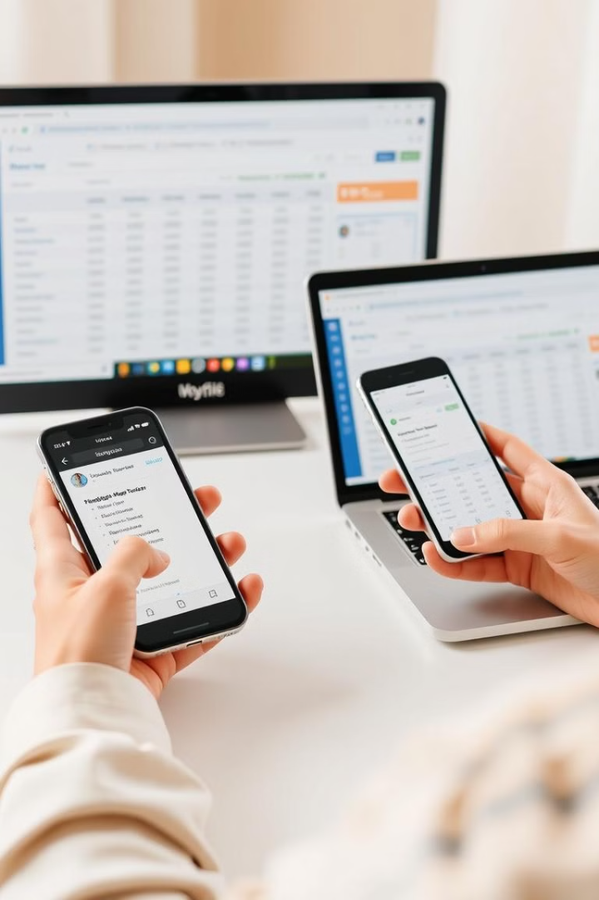



Syncing Across Devices
Mobile App
Access and manage your budget on the go.
Web App
Enjoy a seamless experience on your computer.
Cloud Sync
Your data is always up-to-date across all devices.

Slide 7
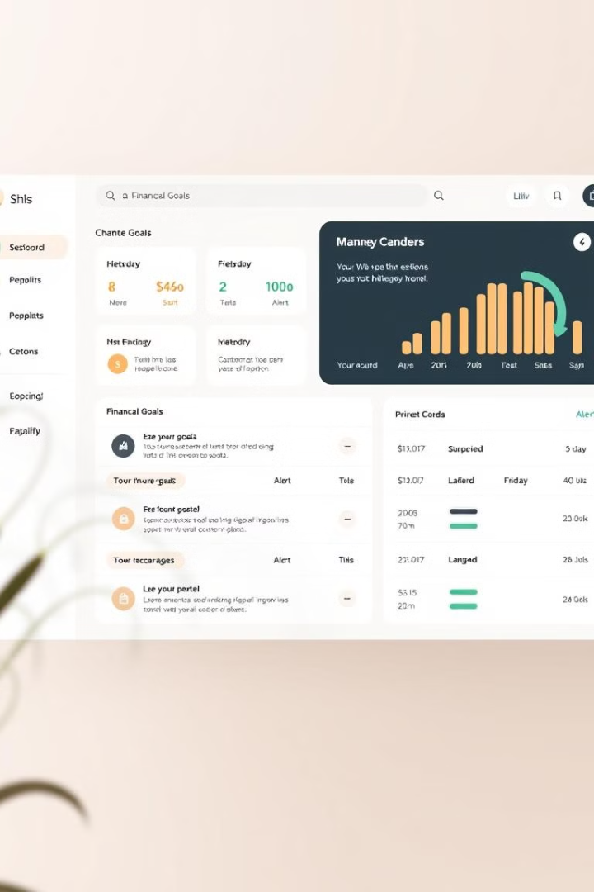
Setting Financial Goals and Alerts
10K
Savings Goal
Set a target amount and track progress.
$500
Spending Limit
Set limits on specific categories.
15
Alerts
Receive notifications when approaching limits.

Slide 8

Conclusion and Next Steps
Our budget tracker empowers you to take control of your finances, make informed decisions, and reach your financial aspirations. Take the first step towards a brighter financial future today!

